Slide 1

C
SMIC WATCH
|Real-Time Asteroid Monitoring Dashboard
by Pookiemons

Slide 2


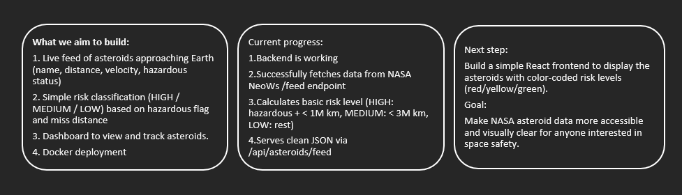
SOLUTION OVERVIEW
Cosmic Watch is a full-stack web platform that fetches real-time Near-Earth Object (NEO) data from NASA's NeoWs API and presents it in an easy-to-understand way.

Slide 3

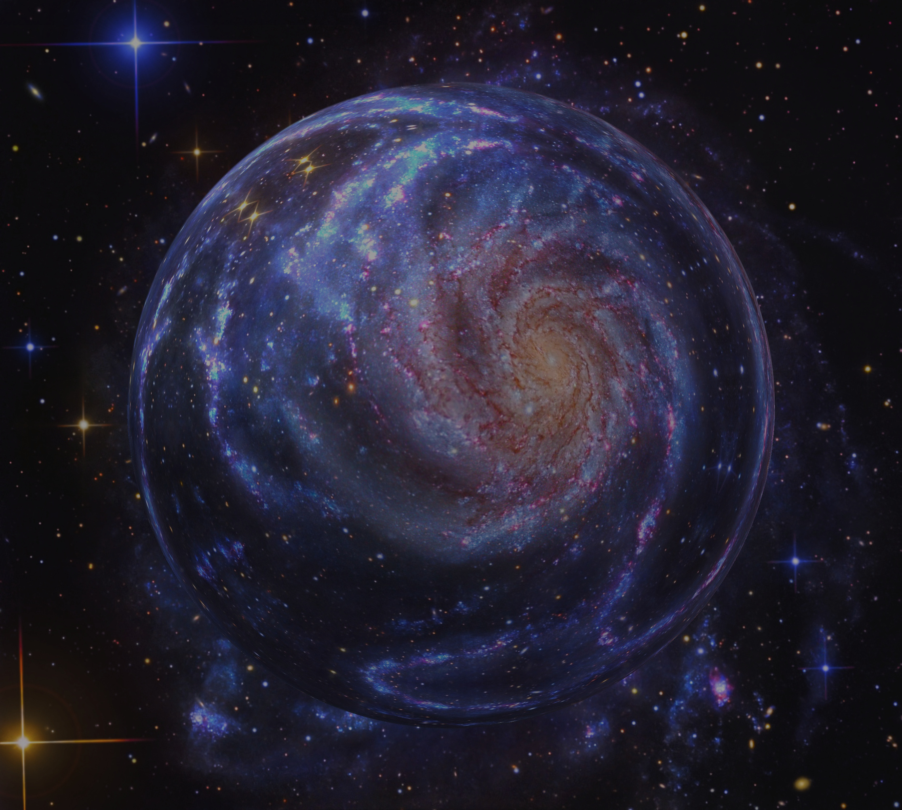
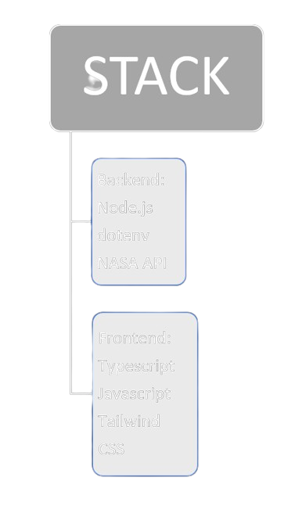
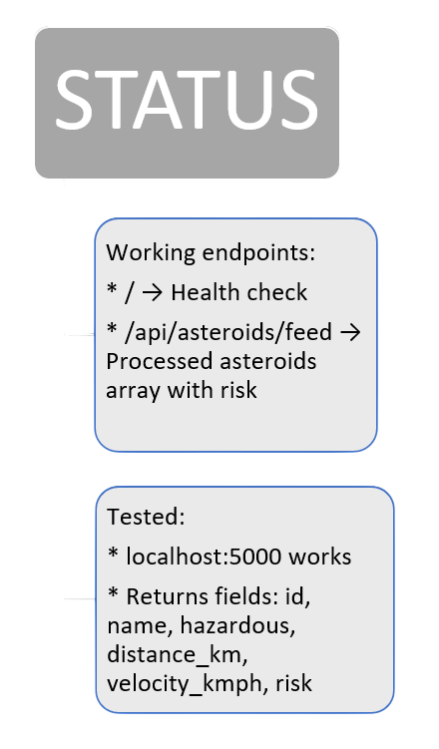

TECH STACKS AND BACKEND STATUS

Slide 4

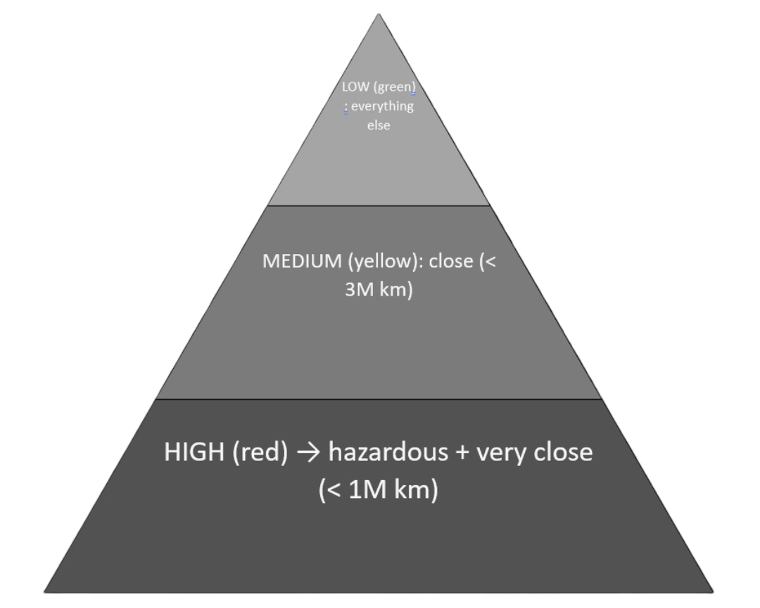
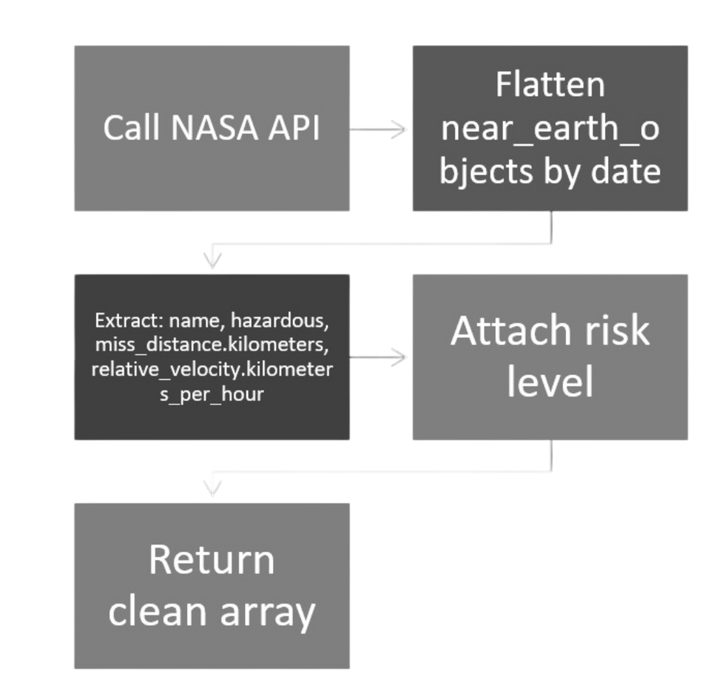
RISK LOGIC & DATA FLOW
RISK FLOW :
DATA FLOW :

Slide 5

HOME
ABOUT
MORE
THANK YOU!
HTTPS://GITHUB.COM/CCXAXO/IITBBS_POOKIEMONS_WEB
< BACK

